Slide 1
Evaluation of Input Modes for BSAFE: Women’s Wearable Safety Device
Yassaman Rezvani Siju M. Philip Chanpreet Singh
School of Information Technology

Slide 2
ABSTRACT
The primary goal of this study is to identify and evaluate the preferred mode of input, ‘press’ or ‘tap’, that women use to interact with a wearable safety device.
Research Question
What would be the preferred mode of input that women use to interact with a wearable safety device?

Slide 3
RELATED WORK
ABHAYA
Suraksha
Smart Foot Device
RAKSHA
FEMME
SafeBand

Slide 4
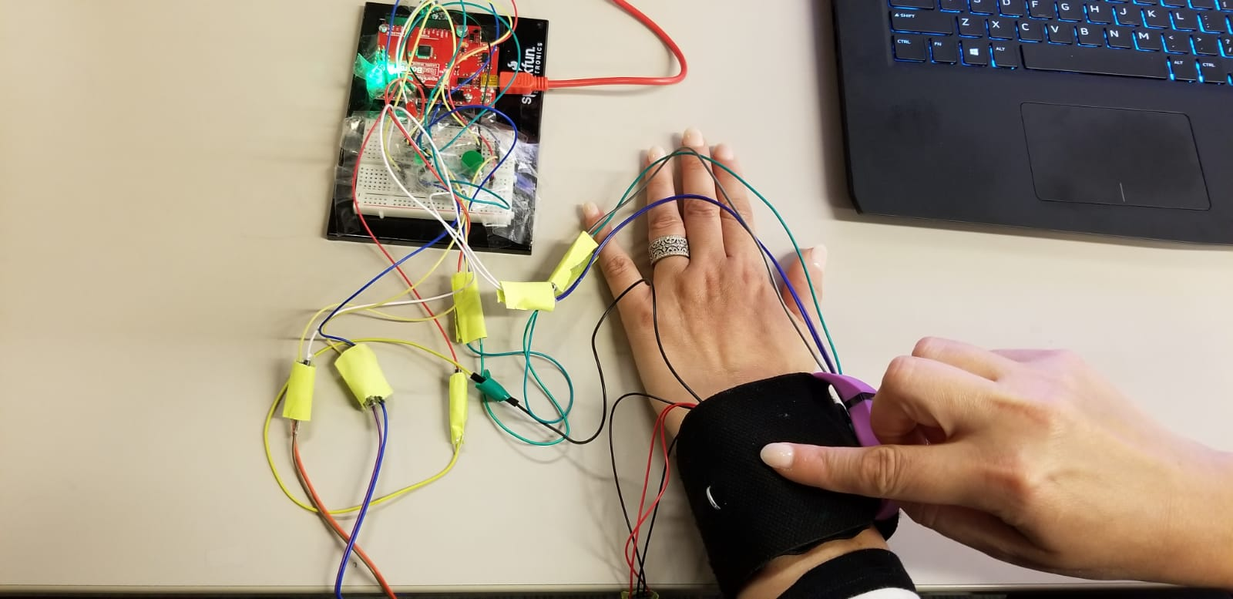
STUDY METHODOLOGY
In order to evaluate the interaction methods, we
designed a prototype with two input modes: a “press” button, and a “tap” surface,
defined a set of criteria for evaluation,
performed pilot usability studies.

Slide 5
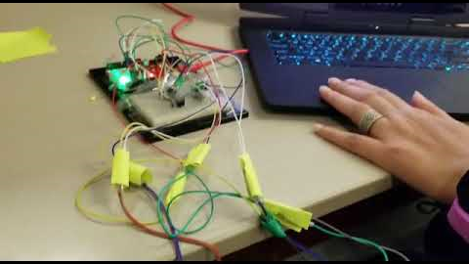
PROTOTYPE

Slide 6
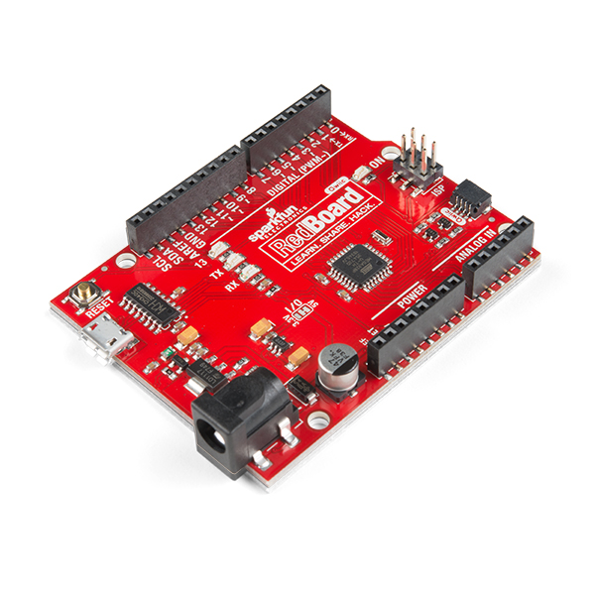
HARDWARE & SOFTWARE REQUIREMENTS
Software:
Arduino version 1.8.8
Hardware components:
Arduino Uno R3 USB Microcontroller kit
Adapter – 5V
Mini vibration motor
Led, Cables and Connectors
PCB and Breadboards

Slide 7
EXPERIMENT DESIGN
Participants - 14 Female
Age above 18
Collect
Pre-questionnaire - to collect participants’ demographics,
Post-questionnaire - to collect user’s subjective satisfaction
Interview questions
Tasks
“PRESS” then “TAP”
“TAP” then “PRESS”

Slide 8
HYPOTHESES
H1: Pressing is women’s preferred mode of input
H2: Pressing results in less errors

Slide 9
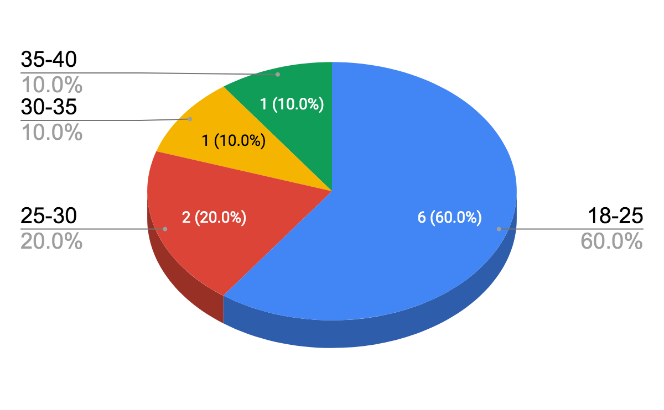
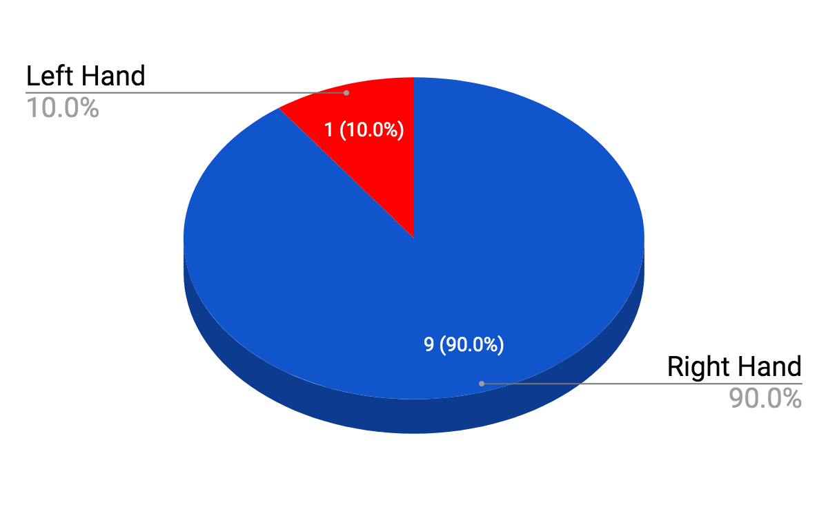
PILOT STUDY (WITHIN-SUBJECTS)
Our pilot study had 10 participants between ages 18 - 40
Independent Variables
Press, Tap
Dependent Variables
Satisfaction, Error Rate
Age Distribution
Dominant Hand

Slide 10
TASKS
Task is divided into 2 Groups
Group 1 – Having 7 females participants 3 of them are sitting and next 4 of them are standing.
Group 2 - Having 7 females participants 4 of them are sitting and next 3 of them are standing.
Task 1: Group 1 tests the “press” mode (10 times)
Complete the post experiment questionnaire (Linkert Scale)
Task 2: Group 2 tests the “tap” mode (10 times)
Complete the post experiment questionnaire
Interview Questions

Slide 11
RESULTS
Serial | UX Type | Score (M ± SD)
 |  | Tap | Press
A | Satisfaction Level | 4.4 ± 0.69 | 4.2 ± 0.92
B | Ease of Use | 4.3 ± 1.06 | 4.3 ± 0.67
C | Easy to Learn | 4.5 ± 0.97 | 4.7 ± 0.48
D | During use, I feel confident | 4.3 ± 0.67 | 4.4 ± 0.69
E | Willingness to Use the System in Future | 3.9 ± 1.10 | 4.0 ± 1.05
F | Recommend to Others | 4.0 ± 1.05 | 4.3 ± 0.82

Slide 12
BSAFE – Complete File

Slide 13
BSAFE – Age 18 between 30

Slide 14
BSAFE – Age 30 between 50

Slide 15
RESULTS ( Age Comparison)
Serial | UX Type | Age (18-30) Score (M ± SD) |  | Age (30-50) Score (M ± SD)
 |  | Tap | Press | Tap | Press
A | Satisfaction Level | 4.71 ± 0.48 | 4.14 ± 1.06 | 3.66 ± 0.57 | 4.33 ± 0.57
B | Ease of Use | 4.85 ± 0.38 | 4.28 ± 0.76 | 3.0 ±1.0 | 4.33 ± 0.57
C | Easy to Learn | 4.85 ± 0.38 | 4.71 ± 0.48 | 3.66 ± 1.52 | 4.66 ± 0.57
D | During use, I feel confident | 4.57 ± 0.53 | 4.43 ± 0.78 | 3.66 ± 0.57 | 4.33 ± 0.57
E | Willingness to Use the System in Future | 4.23 ± 0.78 | 3.86 ± 1.21 | 2.66 ± 0.57 | 4.33 ± 0.57
F | Recommend to Others | 4.42 ± 0.78 | 4.28 ± 0.95 | 3.0 ± 1.0 | 4.33 ± 0.57

Slide 16
FINDINGS
Out of 10 participants (Pilot Study),
Most participants between ages 18 - 30 preferred TAP while the participants over 30 preferred Press.
Two user errors have been recorded with the TAP interaction mode.
Eight participants found the device to be reliable.
Two participants found the device to be helpful.

Slide 17


Slide 18


